Slide 1
Android Dev. Beginners
Quiz Game
Lesson 1

Slide 2
How to play?
We show two different concepts
Discuss what they have in common
Discuss how are they different
Everyone welcome to participate!
Notes:
WTM members share their Android projects
Udacity recommends Nanodegree students to submit their projects through GitHub
Example: each time I follow a tutorial I create a GitHub repo so I can store my results as a reference

Slide 3
Lesson 1A: Views
TextView
vs.
ImageView

Slide 4
Lesson 1A: Views
Common:
Views.
Display something.
Layout parameters:
android:layout_width
android:layout_height
padding
marging
Capture click events.
android:click or onClickListener()
Set a defined style attribute.
style=”@style/MyCustomStyle”
Different:
TextView:
Displays text (String)
android:text
Text styling attributes:
android:textSize
android:textStyle
ImageView:
Displays a picture:
android:src
Scaling attributes:
android:scaleType

Slide 5
Lesson 1A: Dimension
dp
vs.
px

Slide 6
Lesson 1A: Dimension
Common:
Define size, length, width of things.
Numerical value.
Different:
dp:
Depend on physical density of the screen.
Recommended to use.
Use multiples of 4.
Look the same size on all devices.
See next slide!
px:
Actual pixels of the screen.
Not recommended to use.

Slide 7
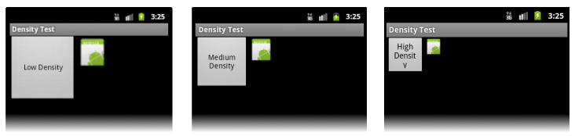
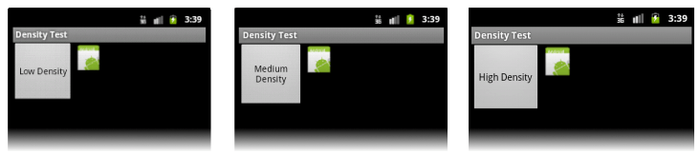
Using PX
Using DP

Slide 8
Lesson 1B: Layouts
LinearLayout
vs.
RelativeLayout

Slide 9
Lesson 1B: Layouts
Common:
ViewGroups.
Contain multiple views.
Layout parameters.
Capture click events.
Set a defined style attribute.
Set a background.
Different:
LinearLayout:
Orientation: Vertical or Horizontal
Distribute evenly with weight attribute.
RelativeLayout:
Child views specify their position relative to the parent view or to each other.

Slide 10
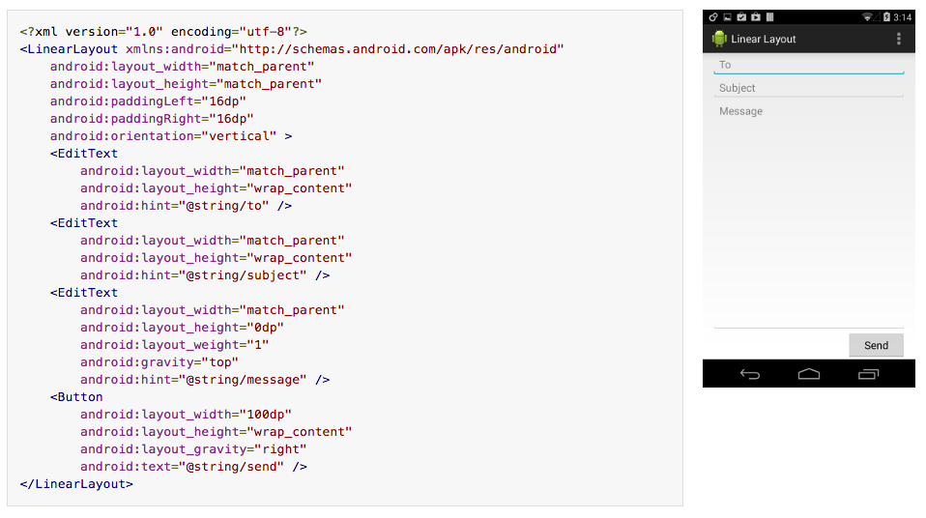

Slide 11
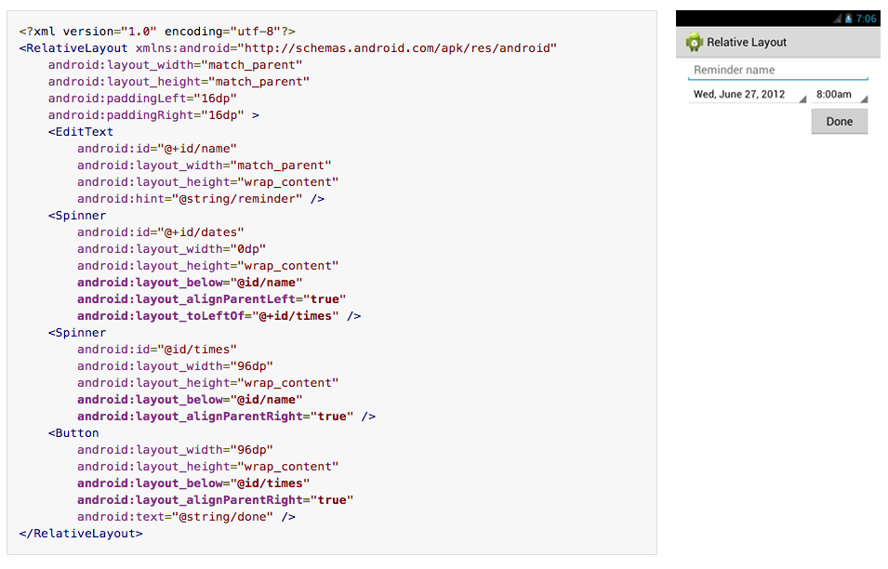

Slide 12
Thanks for listening!
Questions?
Next: Object Oriented Java

